Slide 1
Artificial Intelligence Based COVID-19 Prevention Compliance

Slide 2

Motivation: WHO Guidelines
WHO advises to wear mask and prevent touching Nose, Face and Eyes.
WHO advises to maintain social distancing.
Minimum permissible distance is 1 metre (3 feet).
Prevention is the only way to control spread of Novel Corona Virus and will lead of flattening of curve.

Slide 3
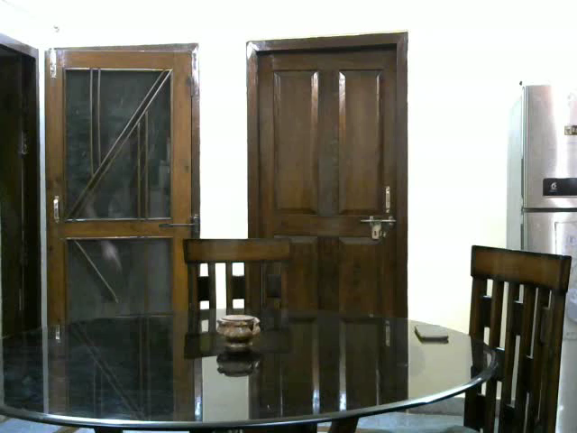
Solution – 1 AI Based Mask Detection System
✔This is our AI Product to check if the person is wearing mask or not.
✔Red: Mask, Pink: No_Mask
✔Contrary to others, this system is highly scalable and can detect multiple streams in optimal time.
✔Can be deployed on edge and cloud both.
✔The USP of this project is that it can detect multiple people (around 100) in one frame.
✔This has great use in surveillance and security purpose to find out who all are following the rules.

Slide 4
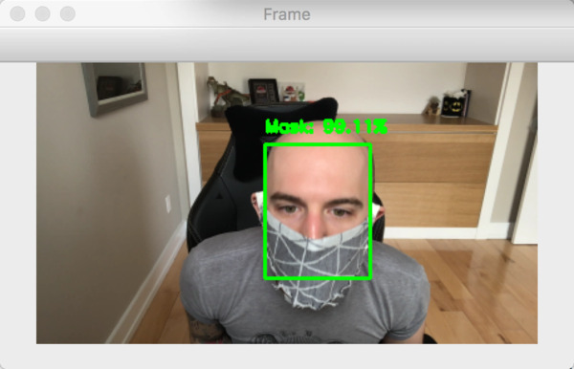
Past work done and Our Novelty
Creator: Adrian Rosebrock
Company: PyImage Search
Method: Prebuilt AI

Slide 5
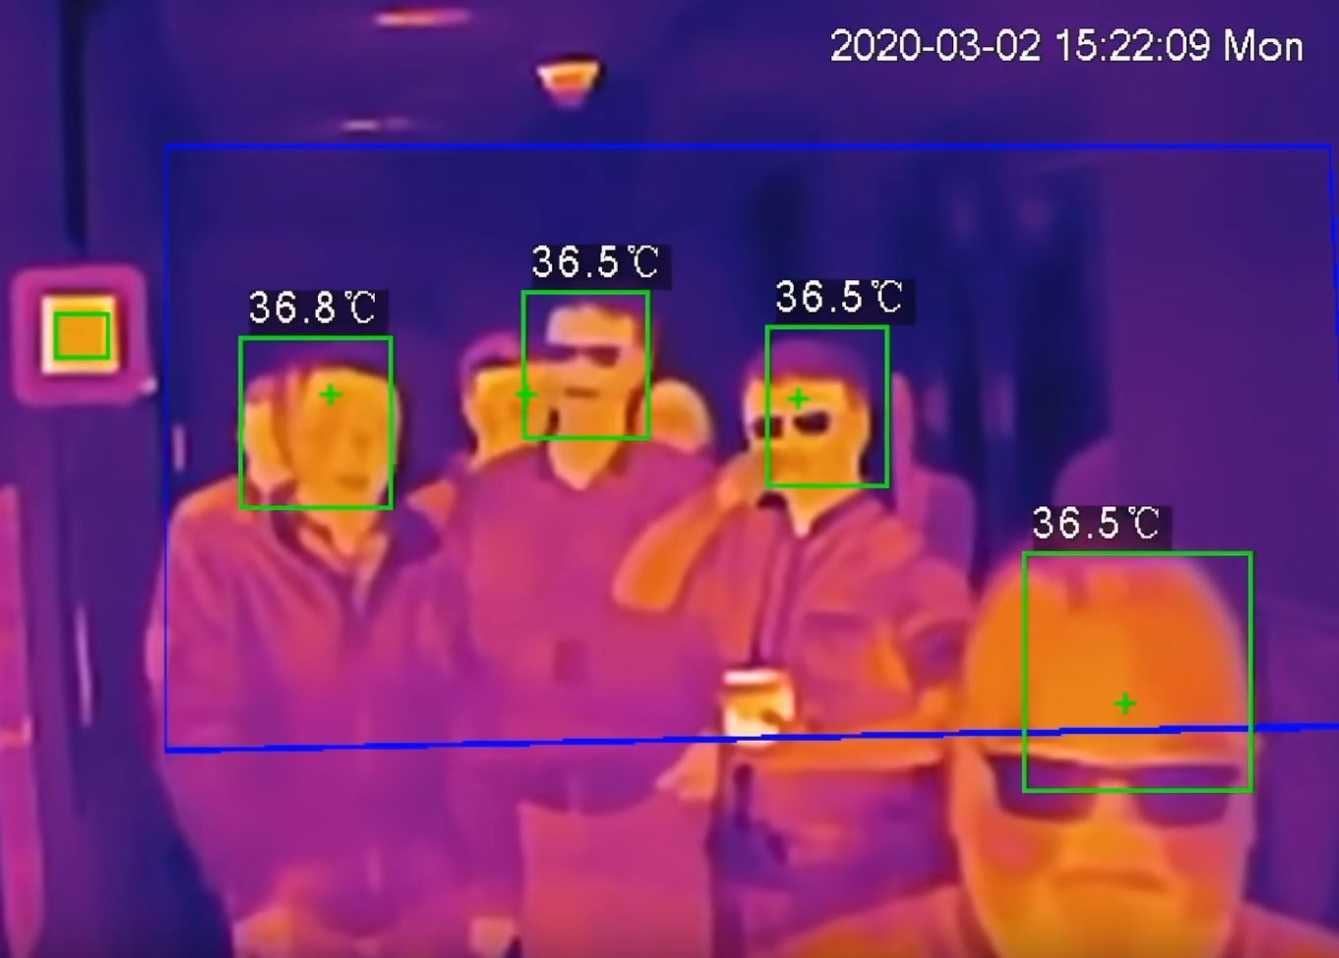
Solution – 2 AI Based Fever Detection at Doorbell
✔This innovation will coupled with our previous mask detection system.
✔It will allow entry only if “The person is wearing mask AND is having normal body temperature
✔Can be deployed on edge and cloud both.
✔The USP of this project is that it can detect multiple people (around 100) in one frame.
✔This has great use at Railway Stations, Hospitals, Cafes and Schools

Slide 6
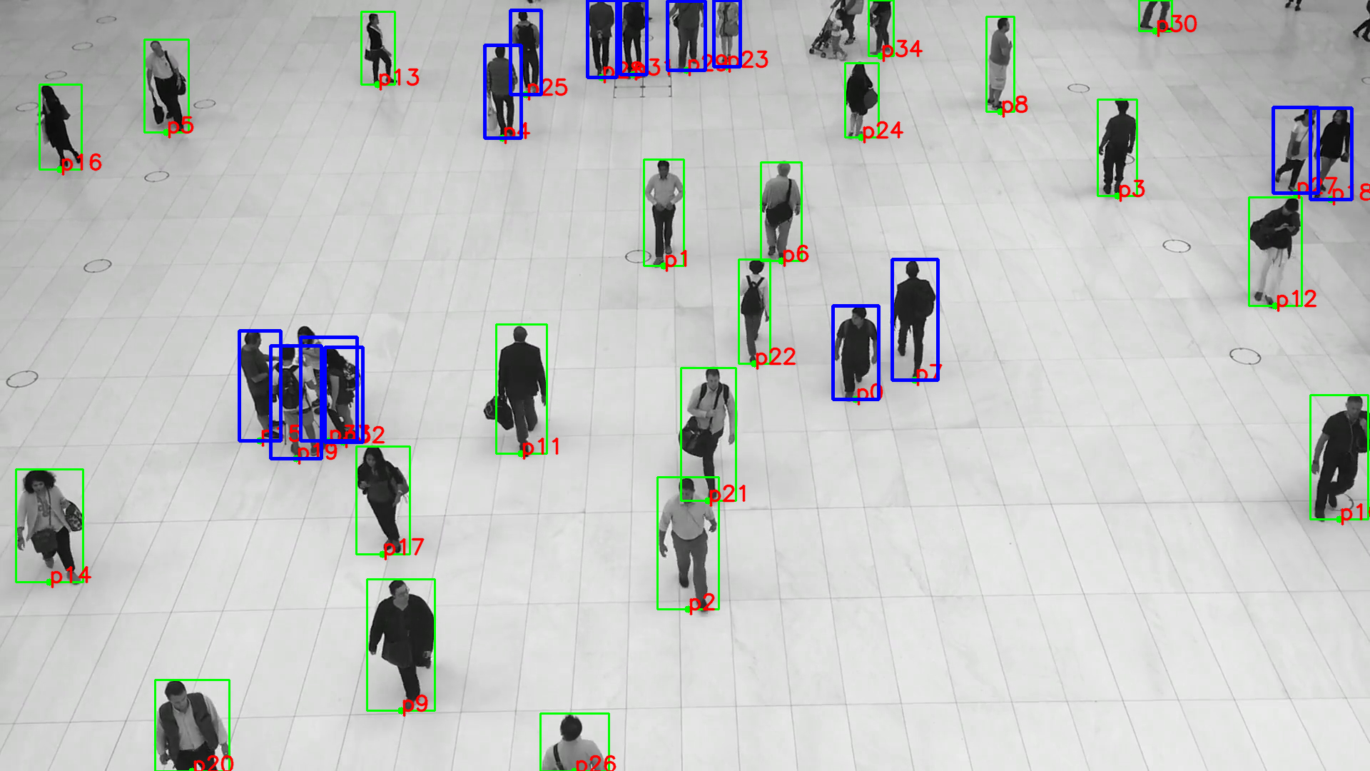
Solution – 3 AI based alert on breaking social distancing
✔WHO has advised to maintain Social Distancing at Workplaces
✔This system raises a trigger alert whenever someone breaks social distancing in monitored area
✔Can be deployed on edge and cloud both.
✔The USP of this project is that it can detect multiple people (around 100) in one frame.
✔We have measured the distance from the bottom mid point, rather than the exact mid-point of the detection box.

Slide 7
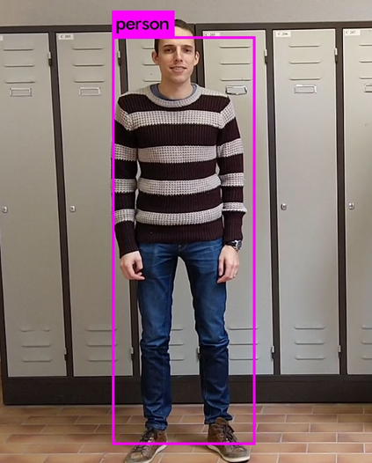
The Mathematics behind the AI
We have detection the person using trained neural network
The neural network returns the coordinates of bounding boxes.
We have taken the distance calculating point as mid point of bottom line segment
The distance considered is Euclidean between two points
.
.

Slide 8
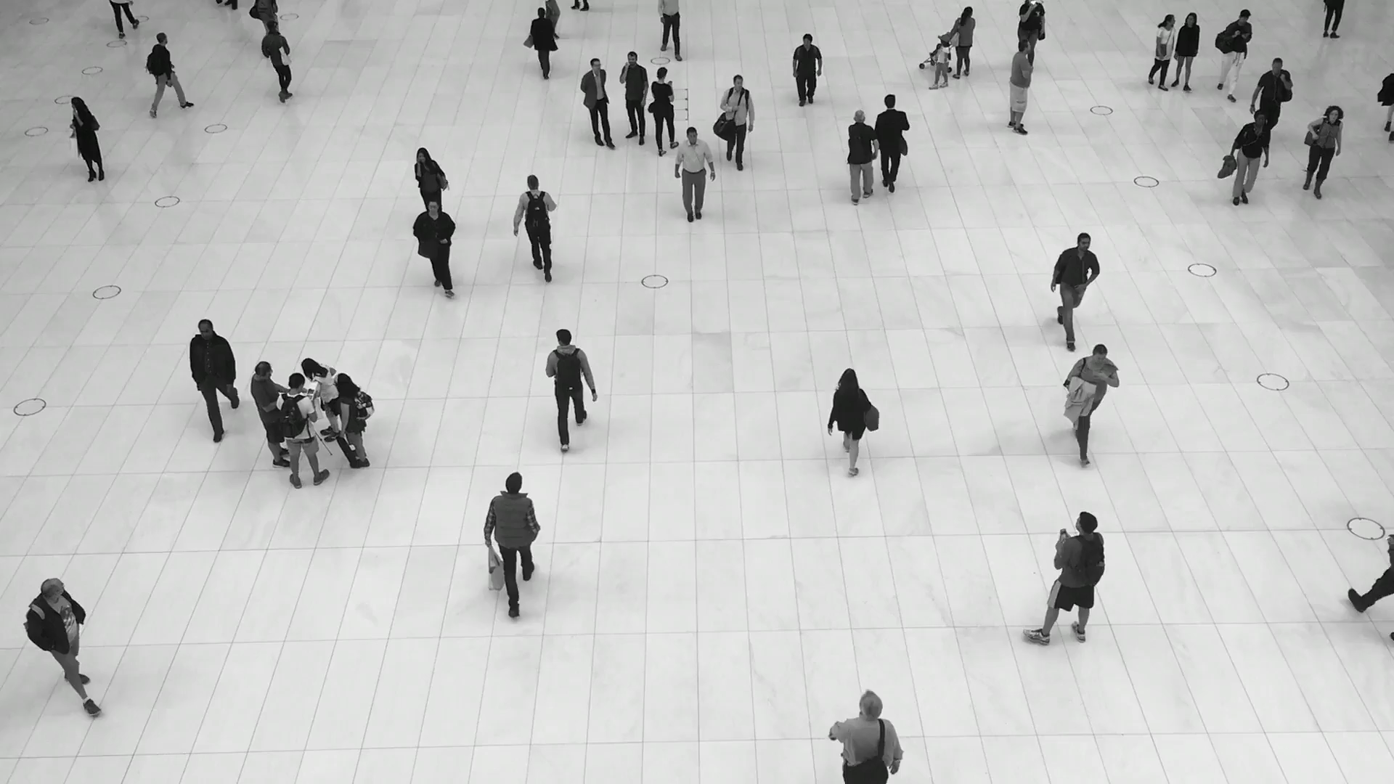
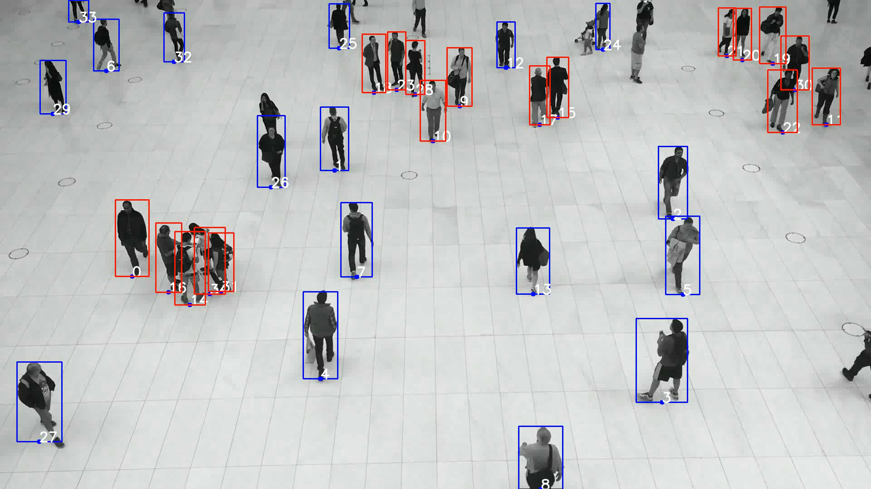
Realtime Output of Our Product
Input Video Stream
Output Video Stream

Slide 9
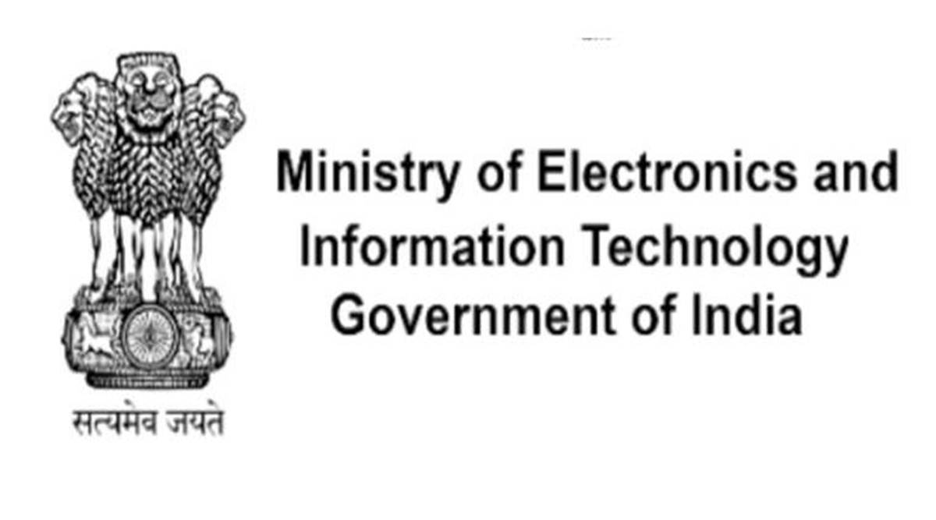




Appraisals

Slide 10
Thank You

